Slide 1
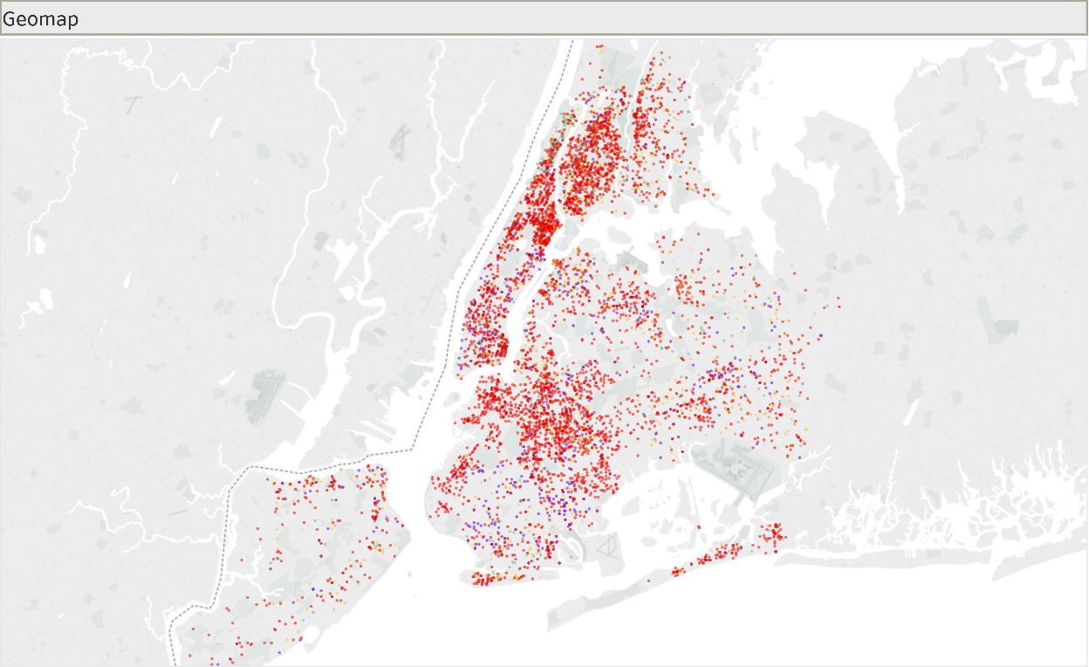
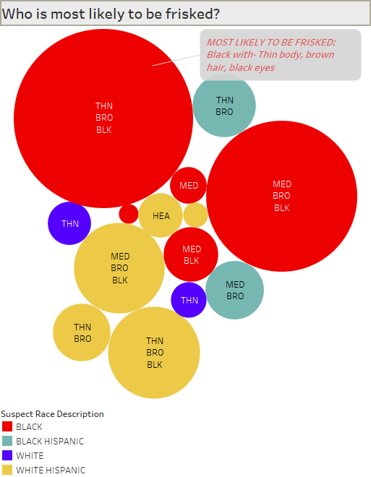


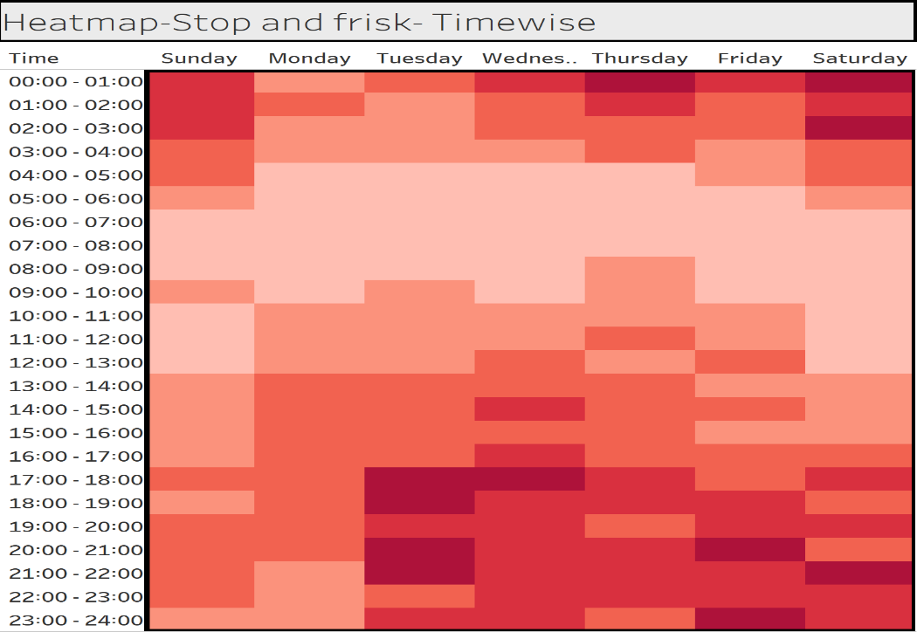
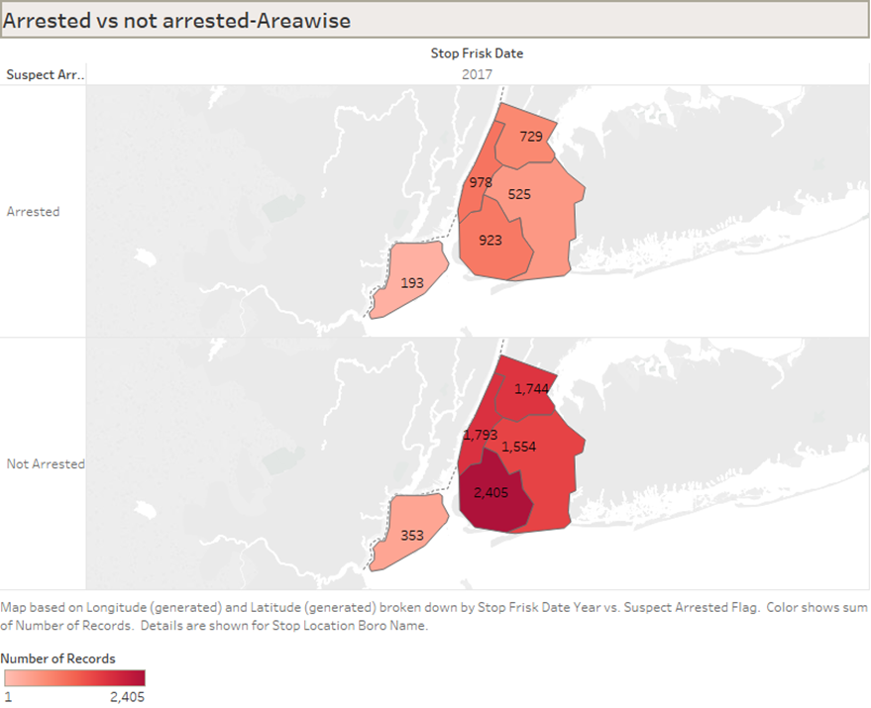


GROUP 3: Nikhil, Nishit and Rushabh.
Figure 1
Figure 2
NYC-STOP AND FRISK 2017
IN NYC, The max frisking cases were in Manhattan- 121 per miles square
Black race , thin body, Brown eyes and black hair were frisked the most.
Figure 4
Figure 3
Frisking is maximum in nights. Least in mornings
Arrest rate for black people: 27%

Slide 2
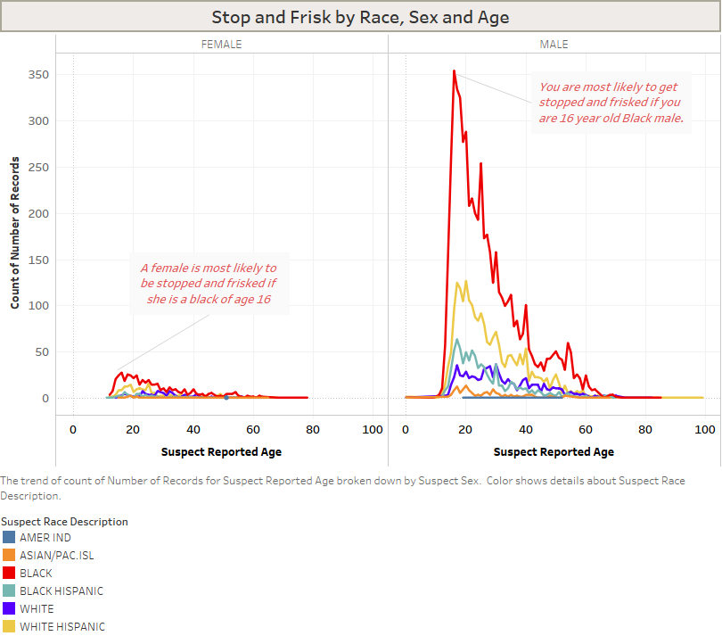
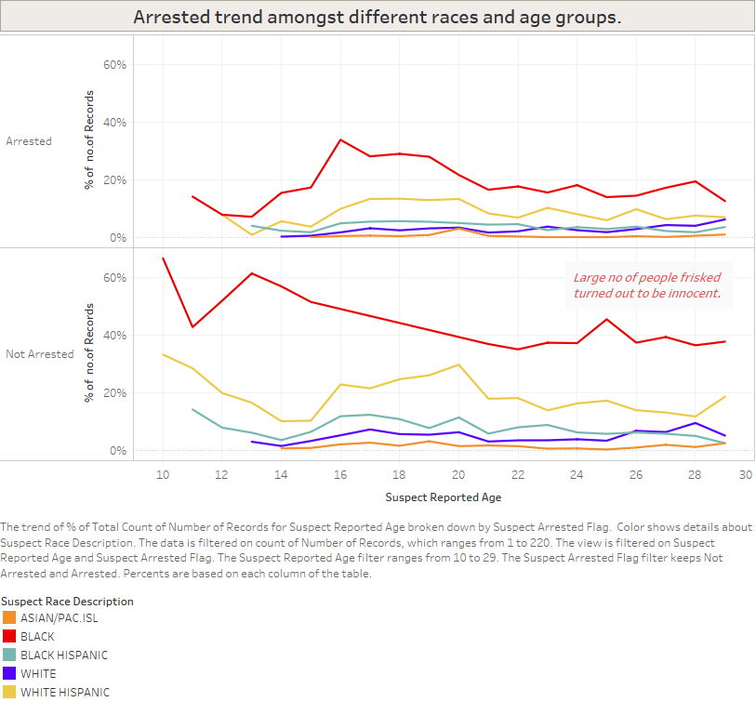
Figure 5
Figure 6
Black people are 7 times more likely to frisked than White people
Males are 10 times more likely to be frisked than Females
Out of the total no. of people stooped and frisked: 70% of the people were INNOCENT.

